Slide 1
Social work
Course instructor: Qubsha Munir

Slide 2

Answer these Questions?
Do you imagine any society without human sufferings?
Do you imagine any society where all members are young and there is no old-age problem?
All members are healthy and wealthy?
All members have their needs satisfied?
A society where there is no discrimination and prejudice?
A society where there is no poverty?
Where every body is rich?
Where everybody is educated?

Slide 3
NO…………….

Slide 4
Because, Human Societies are not Perfect

Slide 5
Now Answer these Questions?
Are you offended when you see poor picking their food from garbage?
When you see poor fighting over a bag of floor or rice?
When you see illness and disease go untreated because health care is not affordable and efficient?
When you see children addicted to drugs?
When children beg in the streets,?
When the deserving candidates do not get job?

Slide 6
Do you want to be involved in shaping a society that strives to ensure a high quality of life and social justice for all social members?

Slide 7
Definition

Slide 8

Social Service is a profession concerned with resolving physio-social problems that exist in a person.
Definition on Google: Work done by professionals to benefit those people in a community suffering from social deprivation.
Scientific Definition: Social Work is a scientific process for helping those in need, those suffering from diseases, material deficiency, disability, and mental disorders.

Slide 9
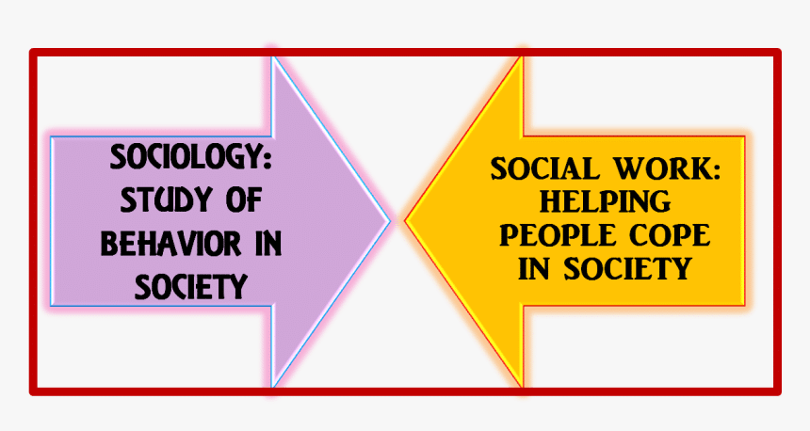
Difference between sociology and social work

Slide 10
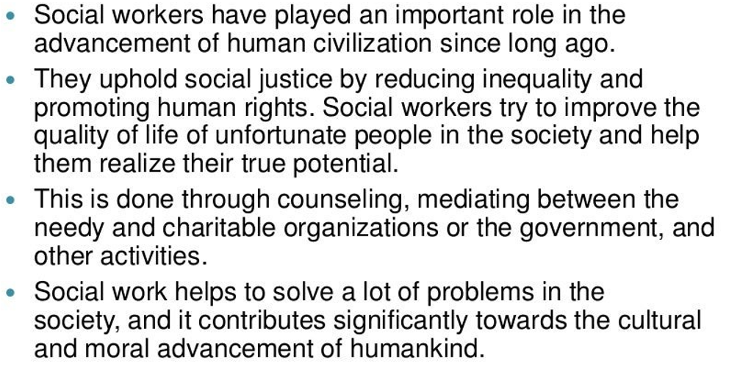
About the Profession

Slide 11
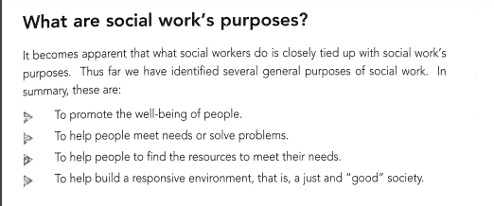

Slide 12
History of Social work

Slide 13
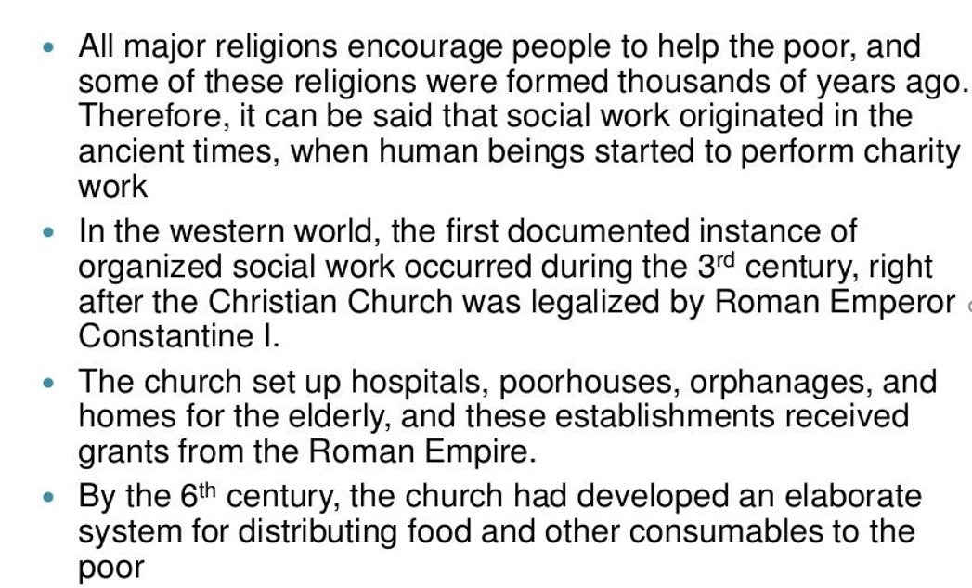

Slide 14
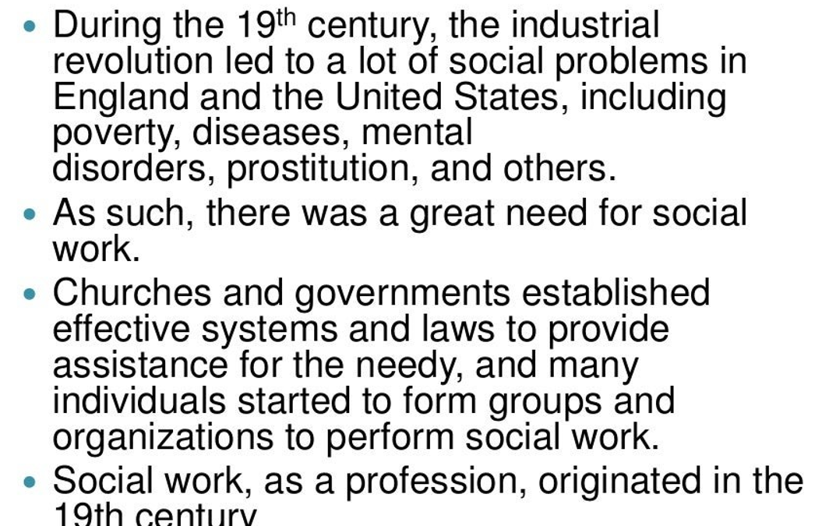

Slide 15
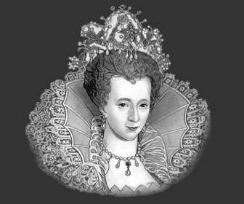
During the 17th century, the Elizabethan Poor Law of 1601 was implemented.
The main purpose of the poor law was to provide work for the poor people.

Slide 16
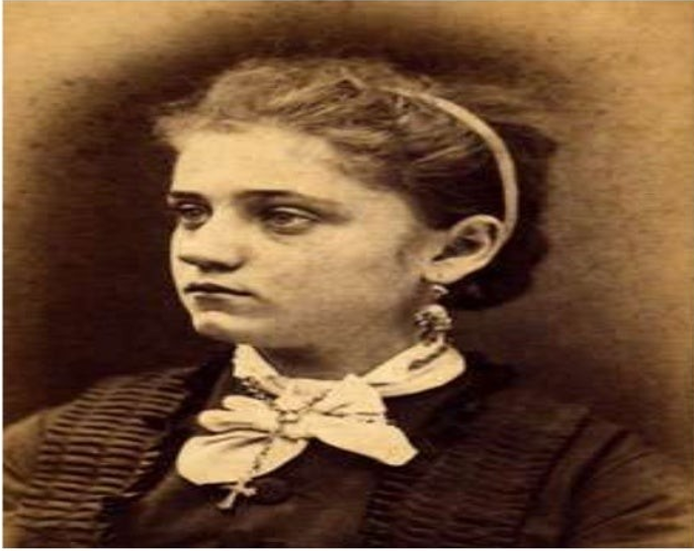
Jane ADDAms, Mother of social work

Slide 17
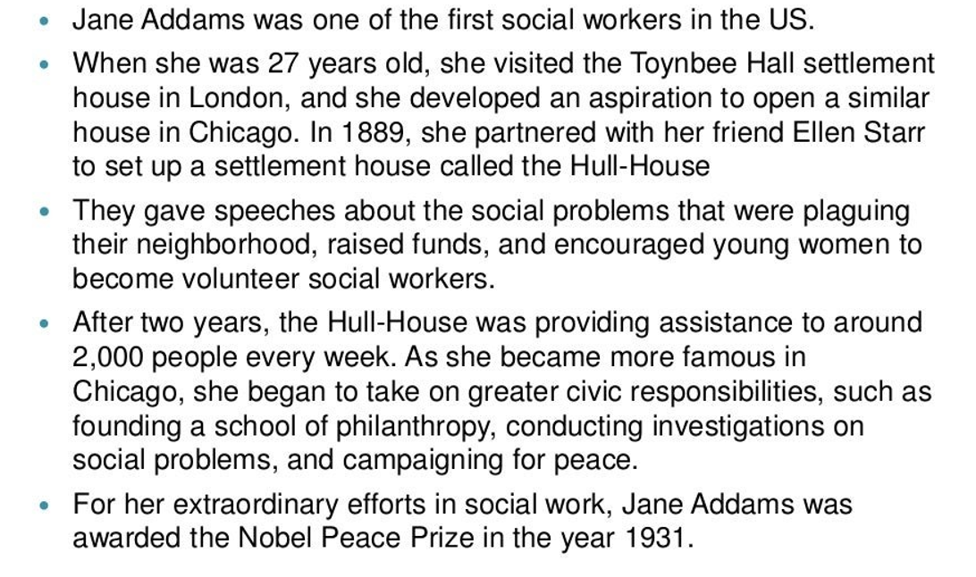

Slide 18
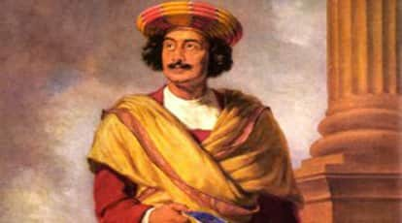
Raja Ram Mohan Roy campaigned against the caste system, child marriage, polygamy, satti, illiteracy of women and the degraded state of widows. He supported widow’s remarriage.

Slide 19
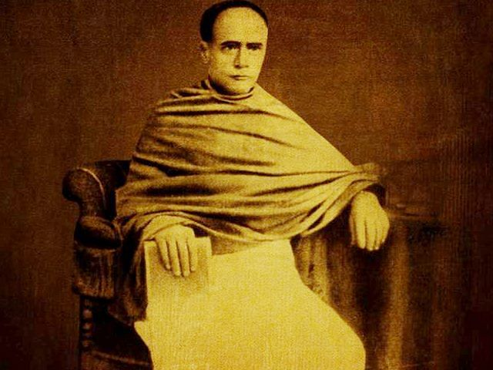
He was the most prominent campaigner for Hindu widow remarriage and girls education in Indian society. It is due to his efforts that the Hindu Widow Remarriage Act of 1856 was enacted.

Slide 20
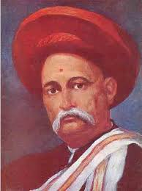
Gopal hari deshmukh promoted the establishment of dispensaries, maternity homes and orphanages.

Slide 21
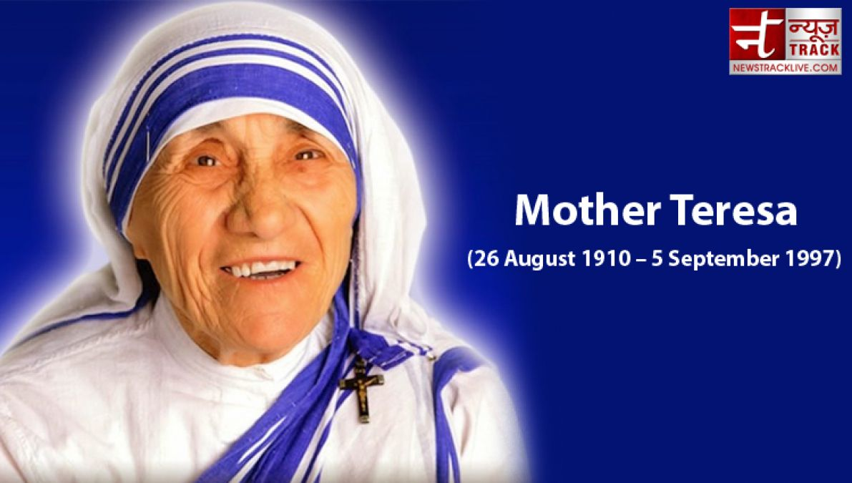
Mother Teresa

Slide 22
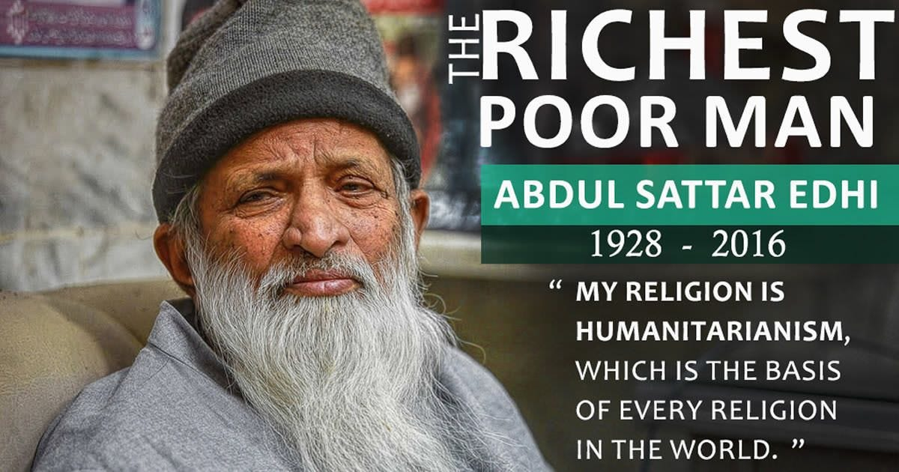

Slide 23
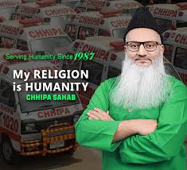

Slide 24
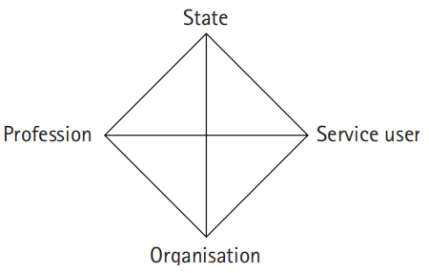
Diamond Model

Slide 25
State
Key factors:
Roles of central government and local authorities.
National policies, taxation and government spending.
Roles of Parliament, courts, regulatory bodies.
Political conflict about the proper role of the state.

Slide 26
Profession
Social policy, social work and other social professions expert-led activities. (e.g. health professionals, teachers, lawyers, community workers).
Service users

Slide 27
Organization
Social policy, social work and other social professions as activities that are shaped by their organizational setting.
Key factors:
Type of organization – (e.g. local authority), voluntary or business?
Budgets.

Slide 28
An important feature of the diamond is that there are tensions within each of the four points as well as between them.
So, within the state there may sometimes be conflict between political priorities and court decisions, and there is often tension between central and local government.
Limited resources.

Slide 29
Social Construction of Social Work Theory
An idea that has been created and accepted by the people in a society.
Social constructs are ideas that have been created and accepted by people in a society often dictating how people “should” behave or identify in relation to others.
Social constructs don’t have meaning until a society gives them meaning.

Slide 30
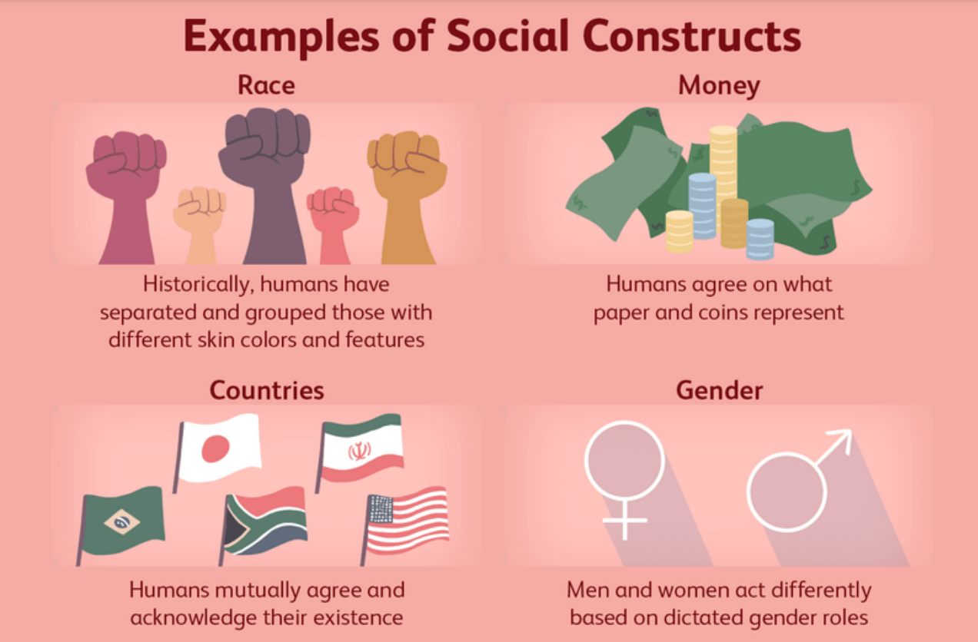
Examples of Social construction

Slide 31


Gender role: Gender is not inherent. Genders are the socially constructed roles, behaviors, etc. that society considers appropriate for "men" and "women".
Fashion: The idea of what type of apparel is considered fashionable is an example of a social construct that changes quickly. What is fashionable one year may not be fashionable the next, based on how what designers create and influencers share catches on in the larger society.
Beauty is a social construct that has definitely changed over time — and varies widely across cultures. Our ideas about what kinds of physical attributes (like body shape, clothing, hair, makeup, and more) are considered beautiful have even varied widely in the last couple of decades.
Marriage: The concept of marriage is a social construct that is not perceived the same by all groups. Some groups view it as a contract while others see it as a religious sacrament. Within some groups, marriages are arranged while in others the decision of who to marry and whether to marry is a choice.
Money: Currency used as money is made of paper and metal. It only has value because people in society assign value to it. Before paper money and coins existed, people used other items that had value to exchange for goods and services.

Slide 32

Family :The concept of family is a social construct. Some perceive family to be limited to the traditional nuclear unit of mother, father and biological children, while others take the broader perspective that there are many types of family structures.
Geographic borders are often brought up in conversations about keeping people out of a country, region, or neighborhood. But have you ever stopped to think about who created those hard lines and why they keep some people in and others out?

Slide 33


